Slide 1
Review of Year 8 Biology, cells and systems

Slide 2
Review of Year 8 Biology, cells and systems
Basic:
What is a cell?
How do living things grow?
3. Name two structures that plant cells have that animal cells do not have and explain their purpose.
What is the purpose of respiration in humans?
5. If a group of organs work together to perform a specific job, what are they called?
6. How do the skeletal and muscular systems work together to help us move?

Slide 3
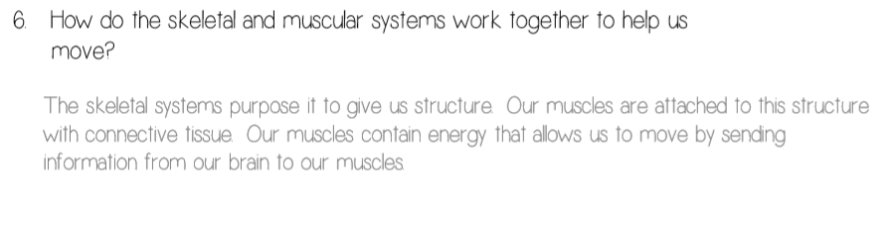
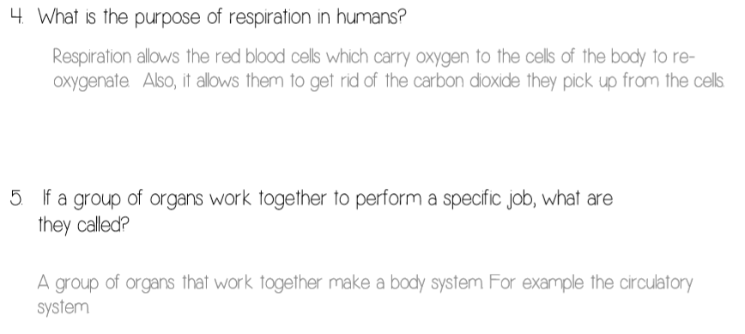
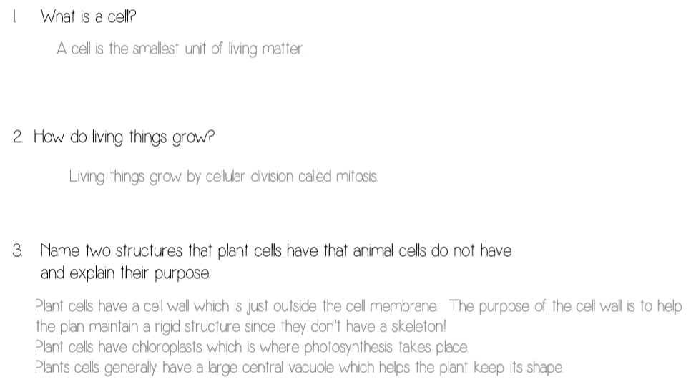
Review of Year 8 Biology, cells and systems

Slide 4
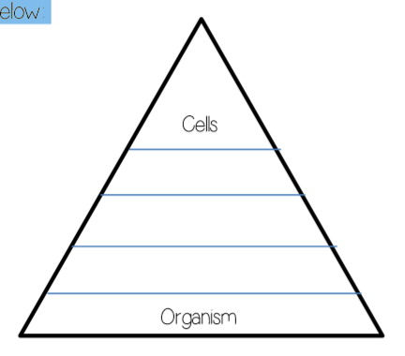
Review of Year 8 Biology, cells and systems
Mid-Range:
Is a cell alive? How do you know? (use the characteristics of a living thing to support your answer and use examples).
What function does a cell’s DNA have? Where is the DNA found?
Chloroplasts are found only in plant cells. What is the function of a chloroplast and why are they not found in animal cells?
How are the needs of the cell related to what the organism needs?
Complete the graphic to the right:
Describe how the circulatory system relies on the digestive system to function.

Slide 5
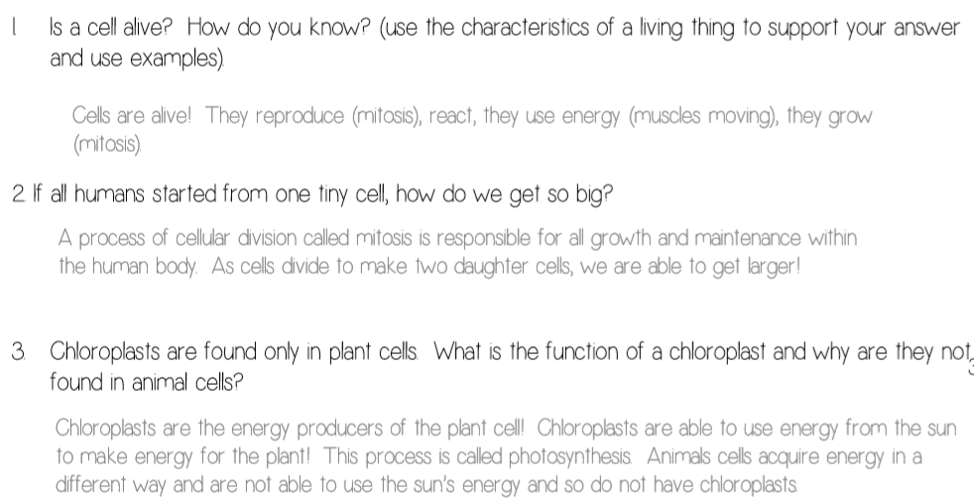
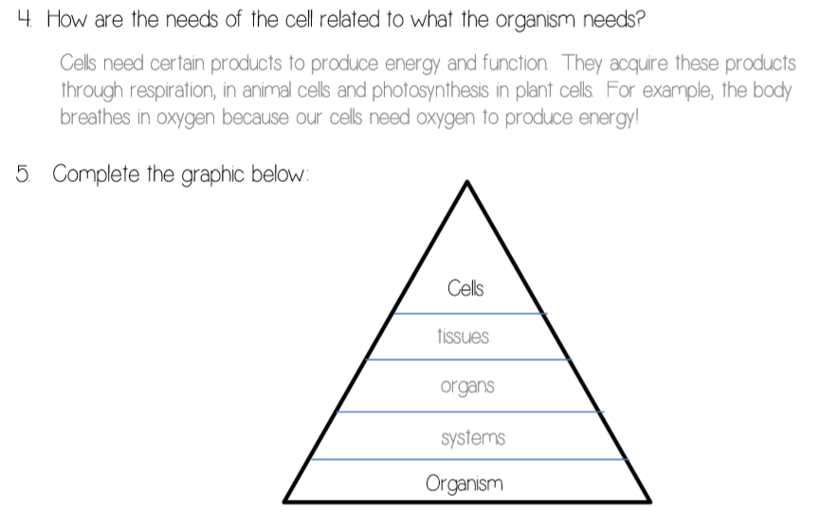
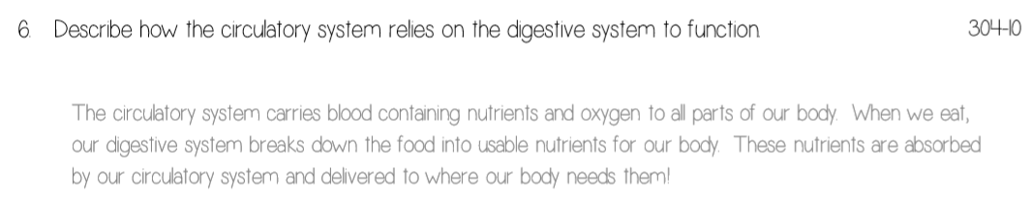
Review of Year 8 Biology, cells and systems
Mid-Range:

Slide 6
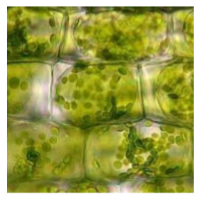
Review of Year 8 Biology, cells and systems
High:
You and a friend are hiking in the woods and you come across something unfamiliar. Your friend picks it up and knowing that you are a scientific genius, asks you if it is alive. How would you determine if the unfamiliar item was alive? Explain.
If all humans started from one tiny cell, why do you think we all look and act differently? Explain using your knowledge of mitosis.
Is the image to the right and animal cell or plant cell? How do you know? Label the diagram.
Explain what would happen to a human muscle cell that is not able to get enough oxygen.
How does a muscle cell rely on a red blood cell?

Slide 7
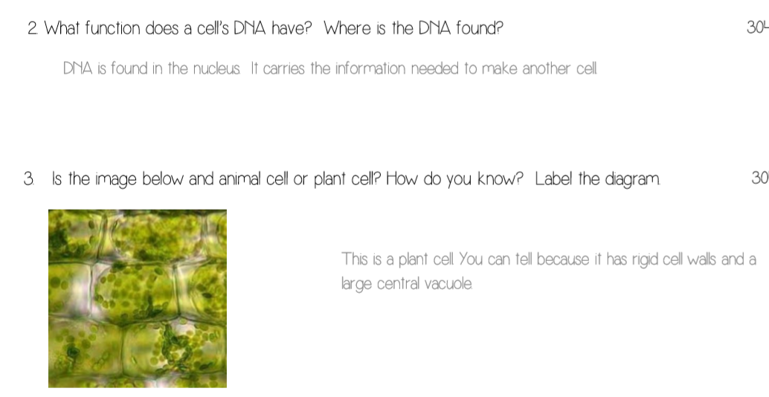
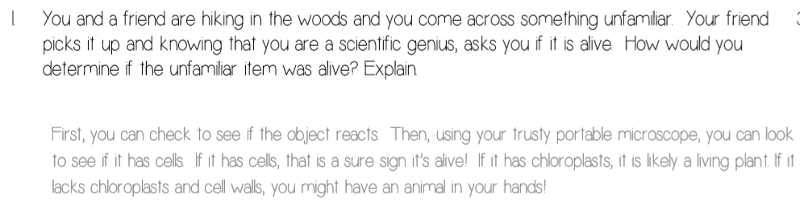
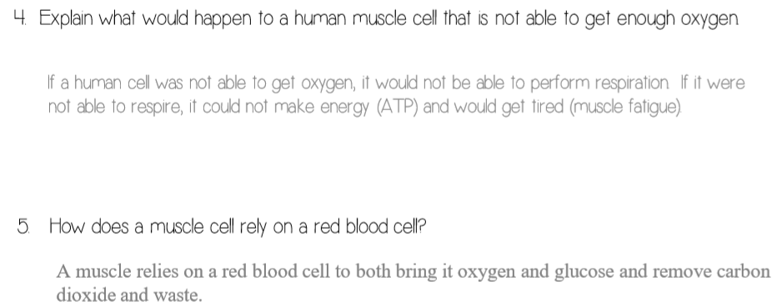
Review of Year 8 Biology, cells and systems
High:

